Slide 1
Diagnosis and Procedure
Presented By –
Sangamesh T

Slide 2
Diagnosis and Procedure
Diagnosis: Medical diagnosis (abbreviated Dx or DS) is the process of determining which condition explains a person's symptoms
and signs.
Types of Diag codes supported in Jiva:
ICD-9 Diagnosis Codes
ICD-10 Diagnosis Codes
Procedures: A medical procedure is a course of action intended to achieve a result in the delivery of healthcare.
Types of Proc codes supported in Jiva:
ICD-9 Procedure Codes
ICD-10 Procedure Codes
Healthcare Common Procedure Coding System (HCPCS)
Current Procedural Terminology (CPT)
Current Dental Terminology CDT
Revenue

Slide 3
HLI Integration
Health language (HL):
Jiva is integrated with Health Language to source the Diagnosis and Procedure codes.
Health Language is a medical content terminology databases and software solution which enable hospitals, electronic medical record system providers (EMRs) and payers to manage, update and map medical vocabularies and administrative codes used in U.S.

Slide 4
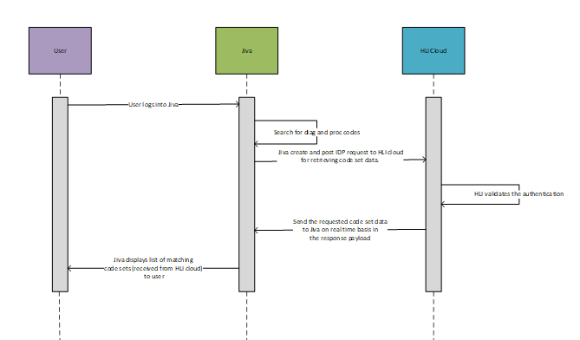
Integration Set Up

Slide 5
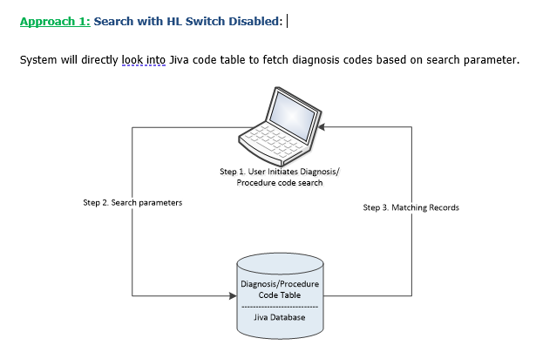
Different use cases -

Slide 6
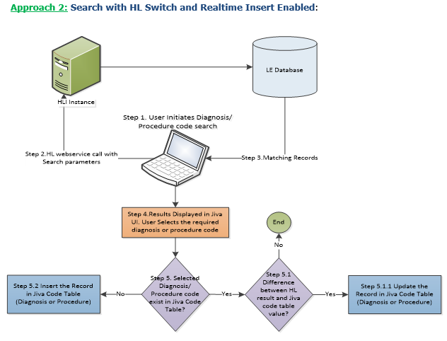

Slide 7
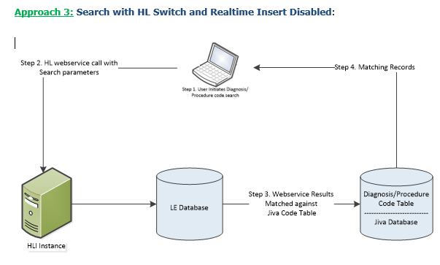

Slide 8
